Slide 1
NLP (Natural Language Processing) & Sentiment Analysis
of Products Reviews
Ling Zhang

Slide 2
Introduction
Exploratory data analysis
CONTENTS
Data visualization
Model Building: Sentiment Analysis
Conclusion

Slide 3
Introduction
“
Sentiment analysis is the method of analyzing consumer sentiment using natural language processing, text analysis, and statistics. Many companies are aware of their customers’ feelings — what they’re doing, how they’re saying it, and what they mean. Instead of reading word by word and trying to figure out its sentiment, nowadays with the advance of machine learning, human just let the machine read news or comments for us and it will answer the sentence’s sentiment or meaning in the faster time.
”

Slide 4

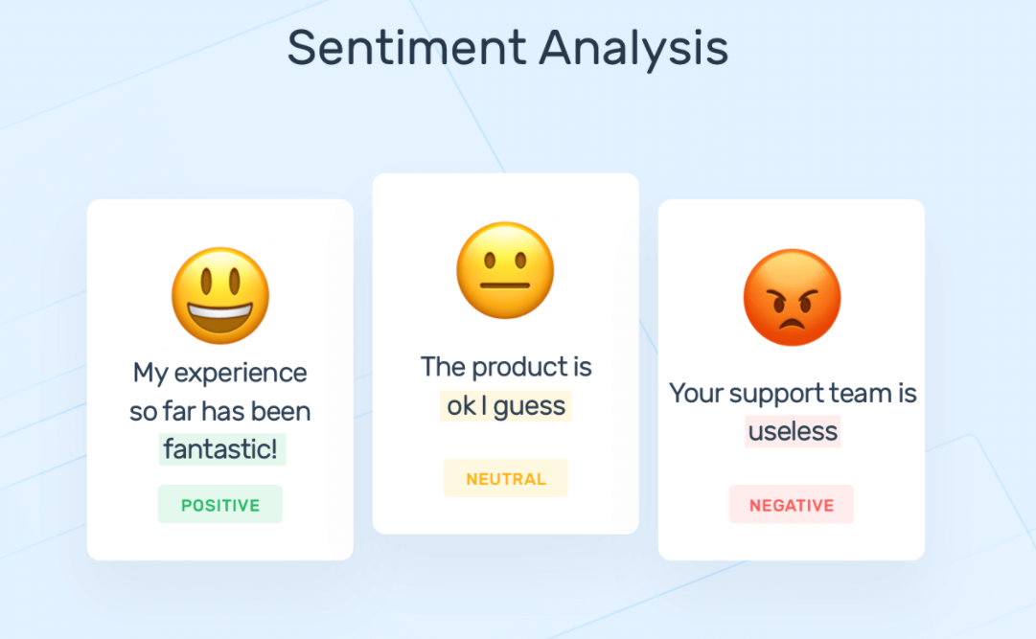
Project Goal
My mission in this project is to utilize machine learning to automatically predict whether the given comment is positive or negative. It helps reduce the significant time that the marketing initiatives read every comment and figure out its sentiment.
In this project, I classify individual reviews and determine the overall rating based on individual comments. So that company can get a complete idea of customer feedback and take care of those particular fields. This makes more loyal customers to the company and increases business, fame, brand value, and profits.

Slide 5
Pre-processing and Cleaning
Notes:
Data visualization is the practice of translating information into a visual context, such as a chart or graph, to make data easier for the human brain to understand and pull insights from. The main goal of data visualization is to make it easier to identify patterns, trends and outliers in large data sets.

Slide 6
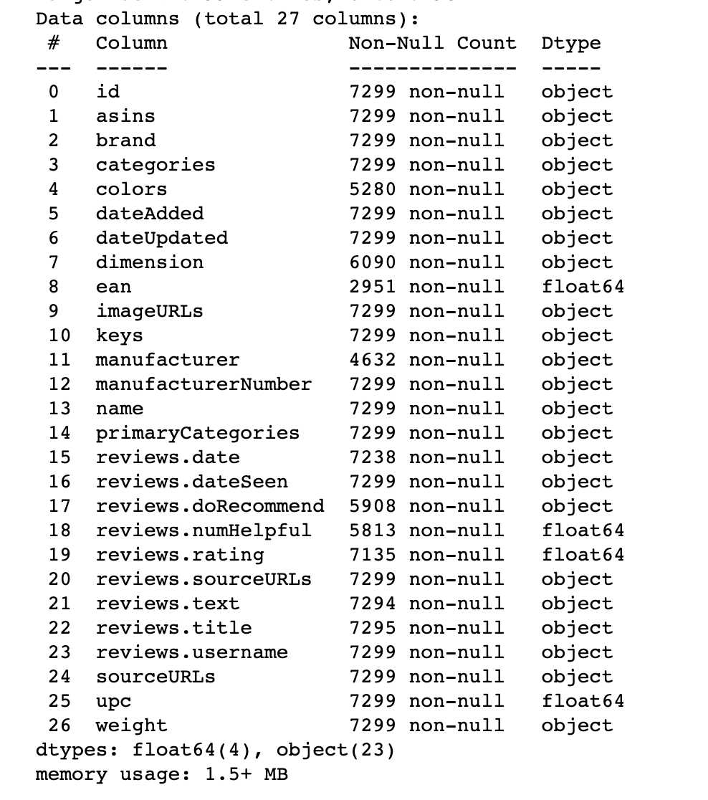
Data Overview
About the dataset:
365.82 MB
Over 1,500 consumer reviews
Only contains electronic products (Kindle, Fire TV Stick, etc)
Basic product information, rating, review text, and more for each product.
From 2010 to 2018

Slide 7
Text preprocessing
Check Missing Values
Replace missing values with zero and drop null values of unnecessary columns to avoid errors in classification and modeling.
Convert all text to lowercase
To avoid the mistake during the training that the word like “We” and “we” might get learn differently, we turn all words with capital letter into lower cases.
Tokenization
One sentence consists of many words, but not all words are important. To analyze each word, we need to split words into single word for each sentence.
Remove none text and special character
Text data might include website link, hashtags etc… These things better be removed from the text before we run the model.
Notes:
6min

Slide 8
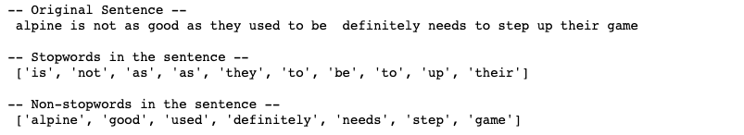
Text preprocessing cont.
Remove stopword
Stopwords are words such as ‘I’, ‘we’, ‘my’, ‘you’, ‘own’, ‘only’,'no','not', etc… These words are not likely to represent particular meaning. The model might consider this as noise, so we remove it as to keep noise level down. Improper selection and removal of stop words can change the meaning of our text. So we have to be careful in choosing our stop words.

Slide 9
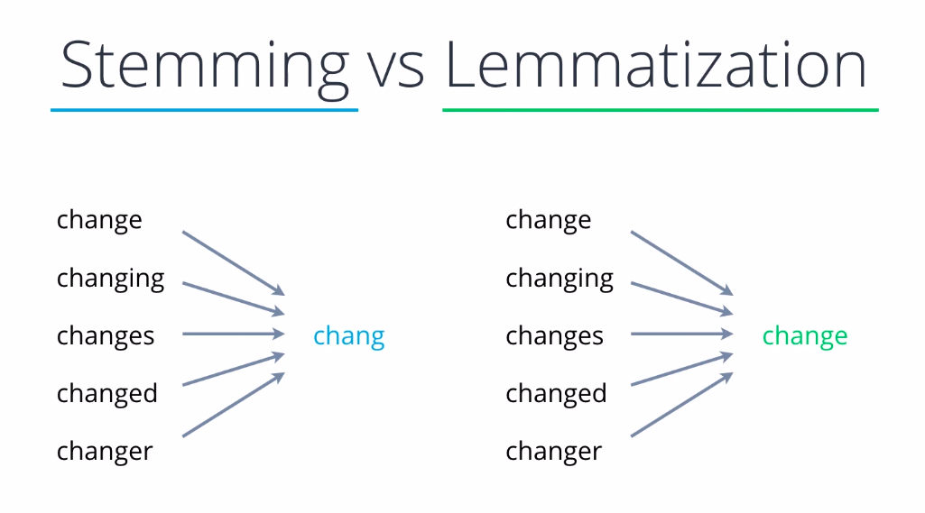
Text preprocessing cont.
Lemmatization vs. Stemming
Stemming is a technique in which a set of words in a sentence are converted into a sequence to shorten its lookup. In this method, the words having the same meaning but have some variations according to the context or sentence are normalized.
Lemmatization is the process to reduce inflected words to their word stem from the text data but still saving the root word belonging to the language.

Slide 10
Data Visualization
Notes:
Data visualization is the practice of translating information into a visual context, such as a chart or graph, to make data easier for the human brain to understand and pull insights from. The main goal of data visualization is to make it easier to identify patterns, trends and outliers in large data sets.

Slide 11
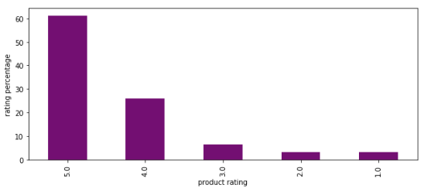
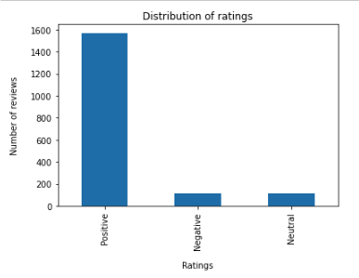



Check rating distribution
This is an important preprocessing phase, we are deciding the sentiment of review based on the overall score. If the score is greater than 3, we take that as positive and if the value is less than 3 it is negative If it is equal to 3, we take that as neutral sentiment
Notes:
Creating 'sentiment' column
This is an important preprocessing phase, we are deciding the sentiment of review based on the overall score. If the score is greater than 3, we take that as positive and if the value is less than 3 it is negative If it is equal to 3, we take that as neutral sentiment

Slide 12

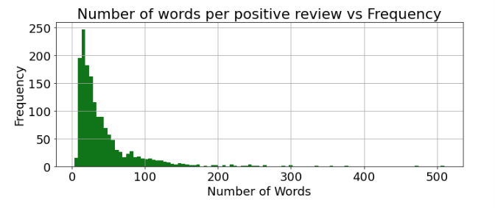
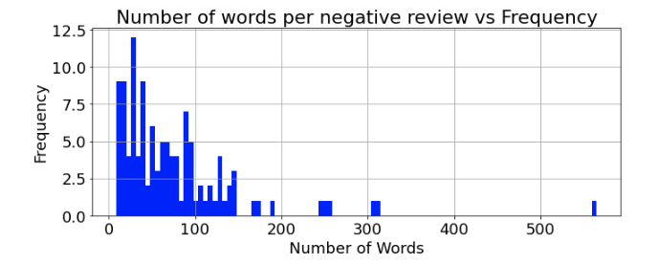
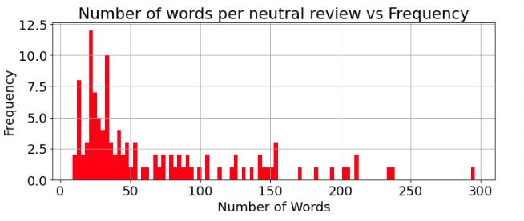
Number of words per review with different sentiment
Negative reviews are longer than positive and neutral reviews

Slide 13
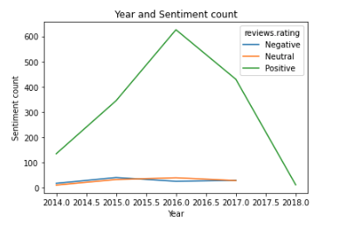
Reviews count over year
From the plot we can clearly see the rise in positive reviews from 2014. Reaching its peak around 2016 then it start going down. Negative and neutral reviews are very low as compared to the positive reviews.

Slide 14
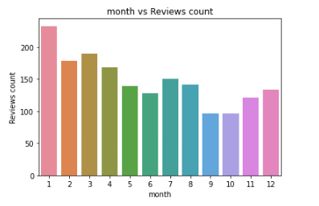
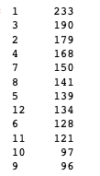
Reviews count distribution
More reviews at the starting of a year
Notes:
From the plot we can declare that more number of positive reviews are having more number of higher reviews, my first assumption is correct

Slide 15
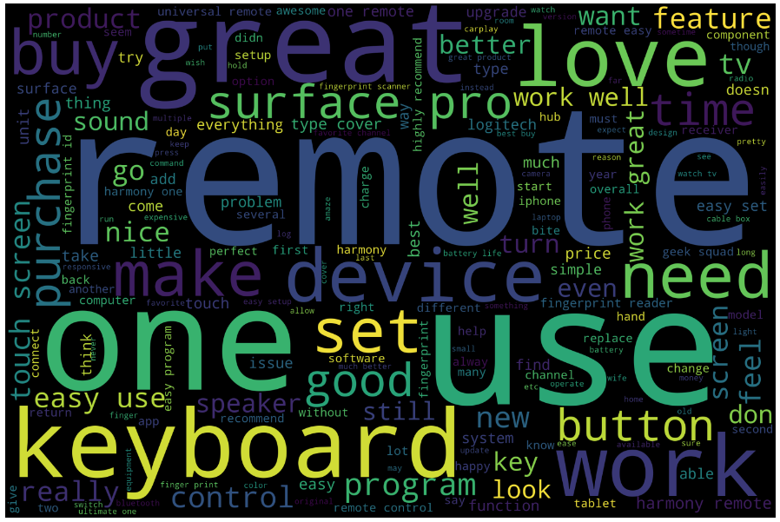
Word Cloud
As a distribution of the text in a visualization way, a word cloud displays the words in different sizes, indicating the frequency of the each word in the text. Looking at the word cloud, it shows that the reviews are related to the electronic products such as: "Keyboard", etc. Some words are related to the customers experiences, such as: "great", "love", etc.
Notes:
Word Cloud is a data visualization technique used for representing text data in which the size of each word indicates its frequency or importance. Word clouds are widely used for analyzing data from social network websites.

Slide 16
Model Building
Sentiment Analysis

Slide 17
Word Embedding
Frequency Based Embeddings
Logistic Regression
K Nearest Neighbor
Count Vectorizer
Support Vector Classifier
Random Forest
Logistic Regression
K Nearest Neighbor
TF - IDF
Support Vector Classifier
Random Forest

Slide 18

Count Vectorizer
CountVectorizer is a great tool provided by the scikit-learn library in Python. It is used to transform a given text into a vector on the basis of the frequency of each word that occurs in the entire text. This is helpful when we have multiple such texts, and we wish to convert each word in each text into vectors.
Example:
“The cup is present on the table”
Data =[‘The’, ‘cup’, ‘is’, ‘present’, ‘on’, ‘the’, ‘table’]
This can be vectorized as

Slide 19
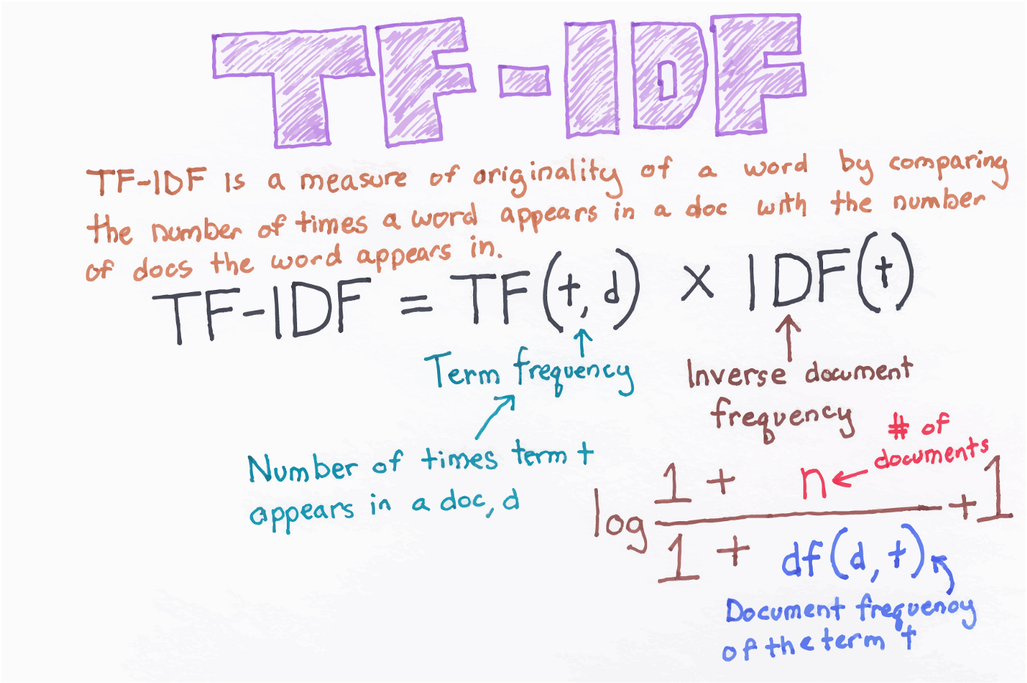
TF-IDF Vectorizer
Term Frequency Inverse Document Frequency. This is very common algorithm to transform text into a meaningful representation of numbers which is used to fit machine algorithm for prediction.

Slide 20
Vectorizers with Classifiers
I will use count and TF-IDF vectorizers to vectorize the text data in the review column and then use four different classification models from scikit-learn models. After that, to evaluate the model on this dataset find out the accuracy, confusion matrix, true positive rates, and true negative rates.
Here are the steps:
Split the dataset into training sets and testing sets
Vectorize the target column
Find the accuracy score and true positive and true negative rates
Run accuracy test with confusion matrix
I will repeat this same process for four different classifiers. The classifiers that will be used here are Logistic Regression, K Nearest Neighbor, Support Vector Machine, and Random Forest Classifier.
Notes:
I split the dataset into training and testing every time I trained a model because certain train-test split may have a bias towards a certain classifier.

Slide 21
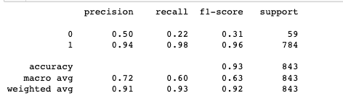
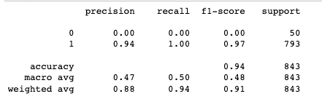
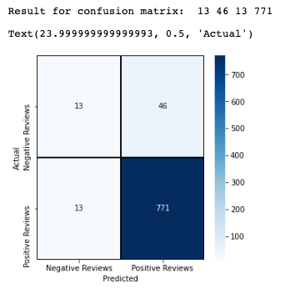
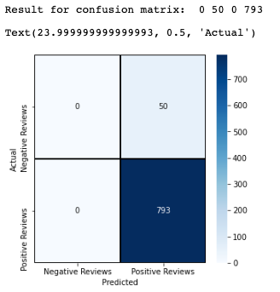
Logistic Regression with Count Vectorizer
Logistic Regression with TF-IDF Vectorizer

Slide 22
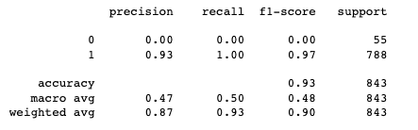
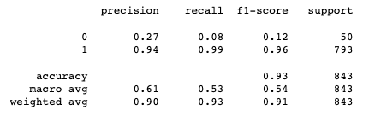
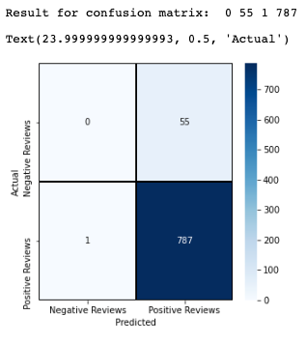
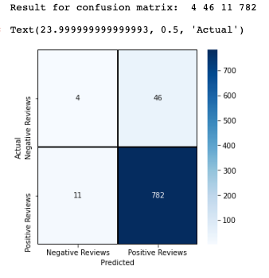
K Nearest Neighbor with Count Vectorizer
K Nearest Neighbor with TF-IDF Vectorizer

Slide 23
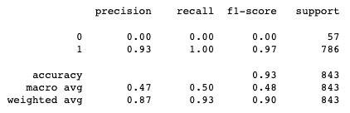
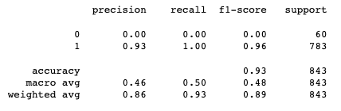
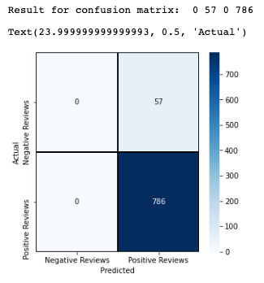
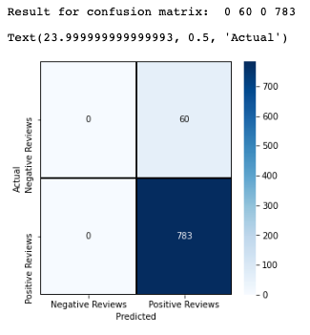
Support Vector Machine with Count Vectorizer
Support Vector Machine with TF-IDF Vectorizer

Slide 24
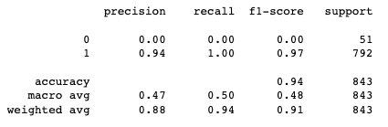
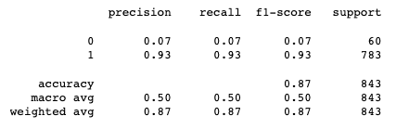
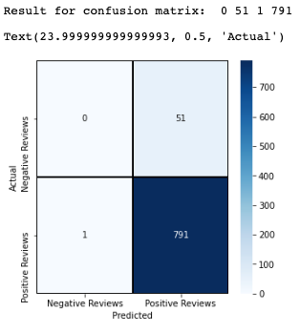

Random Forest with Count Vectorizer
Random Forest with TF-IDF Vectorizer

Slide 25
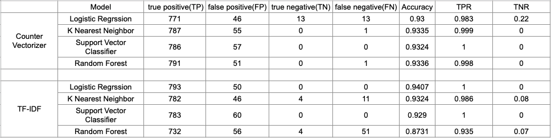
Outcome
1. Logistic regression was the best out of all three classifiers used for this project considering overall accuracy, true positive rate, and true negative rate.
2. The Support Vector classifier does not seem to be suitable for this project. Though true positive rates look very good, true negative rates look really poor.
3. Countvectorizer give number of frequency with respect to index of vocabulary where as tf-idf consider overall documents of weight of words, but from my analysis it has very little difference of performance.

Slide 26
Reference :
Class notes
Consumer reviews of Amazon products. data.world. (2019, June 25). Retrieved November 15, 2022, from https://data.world/datafiniti/consumer-reviews-of-amazon-products
Generating word cloud in python. GeeksforGeeks. (2021, July 5). Retrieved November 14, 2022, from https://www.geeksforgeeks.org/generating-word-cloud-python/#:~:text=For%20generating%20word%20cloud%20in,from%20UCI%20Machine%20Learning%20Repository.
Li, M. (2020, October 3). Sentiment analysis - movies reviews. Medium. Retrieved November 14, 2022, from https://medium.com/analytics-vidhya/sentiment-analysis-movies-reviews-b299de4bb1aa
Using countvectorizer to extracting features from text. GeeksforGeeks. (2022, July 7). Retrieved November 14, 2022, from https://www.geeksforgeeks.org/using-countvectorizer-to-extracting-features-from-text/
Hưng, Q. K. N. (2021, April 18). Sentiment Analysis in python-81% accuracy. Medium. Retrieved November 14, 2022, from https://medium.com/@liangnguyen612/sentiment-analysis-in-python-81-accuracy-ab5d694b7ef8
Another twitter sentiment analysis with python — part 4 (count ... (n.d.). Retrieved November 15, 2022, from https://towardsdatascience.com/another-twitter-sentiment-analysis-with-python-part-4-count-vectorizer-b3f4944e51b5

Slide 27
Thank you

